Slide 1







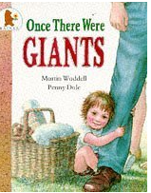
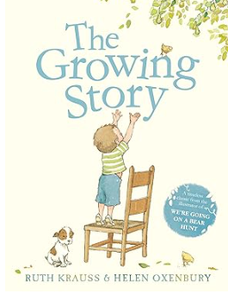
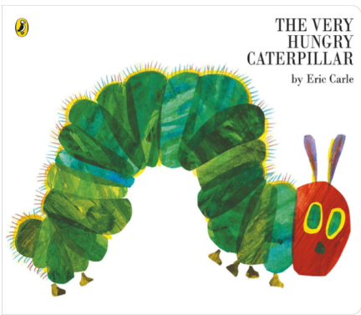
EYFS Summer Term 5
ENGLISH
KEY MESSAGES
We will be looking at a variety of texts related to ‘Growing and Changes’.
As part of our traditional tale learning we will be learning about ‘Jack and the Beanstalk’ through a ‘Make It Groovy’ story, craft and dance workshop.
This term we will be reading ‘The Hungry Caterpillar’ , ‘Once There Was Giants’ and ‘The Growing Story.
MATHS
Welcome to Term 5!
This will be an exciting term in EYFS as the weather starts to improve, which is something to look forward to!
Please continue to ensure your children arrive at school with suitable clothing for the weather. As always, please also ensure everything that comes to school is clearly named.
The children will be continuing with Show and Tell as it builds crucial communication skills ,confidence, and empathy. We are inviting the children to present a personal item such as a certificate, badge or something they have made at home that they are proud of, to their peers. This is an optional activity.
In order, for each child to be able to participate in this we have allocated the below days:-
Thursday– Curiosity (yellow) and Compassion (red)
Friday – Courage (green) and Challenge (blue)
In Maths, this term we will be building on our previous number and numerical pattern learning through counting, ordinality and cardinality. We then move onto subitising and composition of larger numbers.
Term 5 texts

Slide 2

EYFS Summer Term 5
LEARNING
LEARNING
Our topic for this term is ‘Growing and Changes’.
We will be considering:-
How does the world change and grow around us?
What seasonal change and growth can we see?
How do we grow?
Do animals or insects grow? How? Do they change?
We will be consolidating our learning about the life cycle of butterflies by having our own class caterpillars that we can watch grow and emerge as butterflies!
PE
PE for both classes
will be on a Friday
HOME LEARNING
PHONICS
All children will continue to bring home a “sharing” book each week, for you to read with or to your child, as well as a Read, Write Inc. phonics book for them to read to you.
A phonics homework sheet will be sent out every Friday.
We will be continuing with our phonics . If your child brings home a Read, Write Inc book, they will have practiced this book throughout the week at school. As it is a book that is familiar to them, they might be able to read it at home with increased fluency.
REMINDERS
Any messages or reading comments should be recorded in your child’s reading record please. Your child’s “zippy wallet” will be used for any correspondence between home and school.
Reading records are taken in to be checked on Thursdays ready for book change on Friday.
Please ensure all books are returned by Friday.

