Slide 1

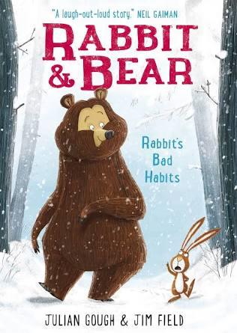

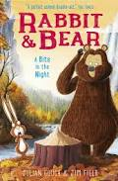
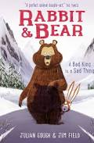
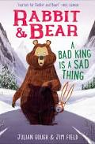
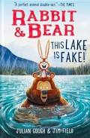


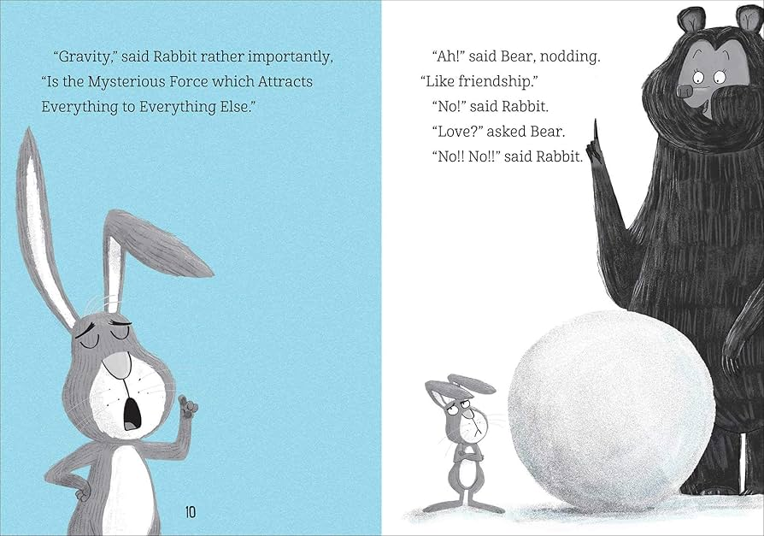
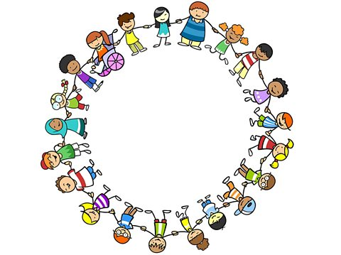

Year 2 – Term 5 – Book Warmer
‘Rabbit and Bear – Rabbit’s Bad Habits’ by Julian Gough and Jim Field
Here are some more of the Rabbit and Bear stories:
This story is about Rabbit and Bear, two friends who live in the forest. Rabbit has some bad habits, like being messy, forgetful, or sometimes not thinking about others. Bear notices these habits and helps Rabbit learn why they can be a problem. Together, they show how friends can support each other, even when someone has bad habits.
Can you create a character description of our two characters, Rabbit and Bear?
Try to use some expanded noun phrases.
Grumpy, frustrated Rabbit.
Smiley and cuddly Bear.
Bear discovers that Rabbit has some bad habits! Can you find out what habit means?
Our theme this term:
Citizenship
Challenge!
At the start of the story, Bear is eager to build a snowman and Rabbit wants to build one too!
Can you design and draw your own snowman?

