Slide 1






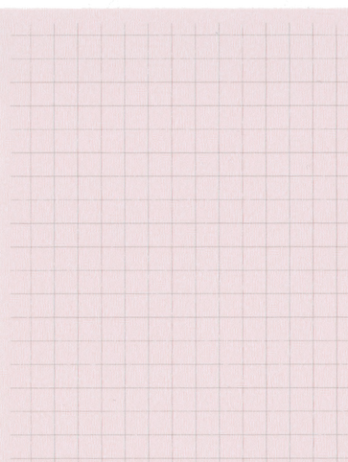

Year 2 Summer Term 5
ENGLISH
KEY MESSAGES
This term we will be exploring the text “Rabbit and Bear-Rabbit’s Bad Habits” by Julian Gough. Through this text we will be learning how to write a non-chronological report. We will be focusing on the correct use of capital letters and full stops, as well as consolidating our learning about commas and concentrating on spelling common exception words correctly.
In our novel study we will be focusing on the characters, learning unfamiliar vocabulary and sequencing the events of the story.
MATHS
Welcome to Term 5! We hope you had a lovely break.
We are hoping that the summer term brings warmer weather! Please ensure children bring in sun hats and water as needed.
Our whole school theme this term is “Citizenship”. We will be thinking about how we can work together to make a positive difference to our society and everyone around us.
In maths this term we will consolidate our learning of calculations using the four operations.
We will then move on to learning fractions, focusing on finding halves, quarters and thirds of shapes and numbers.
Term 5 text

Slide 2

Year 2 Summer Term 5
COMPUTING
In Computing we will be learning about data and statistics. We will collect information and present it digitally on a pictogram and block diagram, and use this information to ask and answer questions.
MUSIC
PSHE & RE
In music this term we will revisit our learning of how to play the glockenspiel. We will learn to sing the song “When the Saints Go Marching In”, and then learn to play the tune on the glockenspiel.
In PSHE we will be thinking about online safety and image sharing.
In RE, we will continue to consider the question “How should we care for our world and why does it matter??” with a focus on Judaism.
Home Learning
PE and Forest School.
Zippy wallets will be collected in on a THURSDAY to be checked. Books may be changed any day, once they are finished.
Please remember to complete TTRS and EdShed regularly to support learning.
Geography
SCIENCE
P.E. and forest school will take place on a TUESDAY. We will also have PE on a Wednesday.
In Science, we will be looking at Plants and identifying the conditions plants need to grow. We are going to conduct our own experiment by planting our own seeds!
Our focus for geography this term is fieldwork. We will be learning about what fieldwork is, and we will be carrying out our own field work both at school and in the local area.
.

