Slide 1








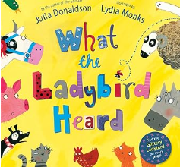
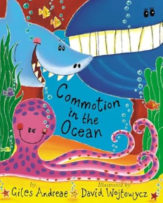
EYFS Summer Term 6
ENGLISH
KEY MESSAGES
This term our topic is " Animals and Habitats ". We will be exploring this topic by reading lots of lovely texts including ‘What the Ladybird Heard’, ‘Handa’s Surprise’ and ‘Commotion in the Ocean’. We will also think about things that have made us happy this year as well as preparing to transition to Year One.
MATHS
In maths this term we will be consolidating our learning on number including subitising, composition, number bonds and comparison.
We will be learning about visualising, building and mapping.
Welcome to Term 6 in EYFS!
We can’t believe we are
already in the last term of
Reception!
As the warmer weather is
finally here, please could you
ensure your child brings a sun
hat and water bottle to school
each day. During the hot
weather please apply sun
cream before school. If you
send your child to school with
sun cream, please ensure that
it is named and that your child
is able to apply it
independently.
.
Term 6 texts

Slide 2

Summer Term 6
PE and Forest School
PE
P.E. days for both classes is Tuesday
Forest school for both classes is Tuesday and Thursday.
Topic
This term our topic is ‘Animals and Habitats’. We will be learning about the different types of habitats and how we can describe them. We will be naming farm animals, minibeasts, safari animals and sea creatures. As well as exploring how we can we sort them.
Our PE focus this term will be Athletics! We will practise our races ready for Sports Day.
Reminders
Please ensure that all items that come into school are clearly named.
Home Learning
All children will continue to bring home a phonics book as well as a sharing book. Phonics homework will continue to be sent home on a Friday. Reading Records and books will be collected in on a Thursday ready for their new books to come home on Friday. ☺
Transition
We are so proud of the children and the progress they have made this year. Towards the end of term we will be thinking about the next stage of their learning journey as they move into year 1. We will be helping their transition by meeting their new teachers and spending time in their new classrooms.
Dates
Wednesday 3rd June
Trip to Tyland Barn
Class Assemblies
Maple – Weds 10th June
Beech – Weds 24th June
Add here

